Slide 1


CSE327 PROJECT PRESENTATION
MERN Stack Movie Ticket Booking
Presented by :
Md Waliul Sakib - 2212570042
Tasmiad Hossain - 2223017042
Faculty : RSY

Slide 2


Problem Statement
Traditional movie ticket booking systems often suffer from:
  Manual or poorly designed seat selection
  Limited real-time availability updates
  Lack of booking transparency
  Inconvenient authentication processes
  No automated notifications or reminders
Target Users
  Movie-goers who want a fast, reliable, and user-friendly booking experience
  Theatre administrators who need an easy way to manage shows, bookings, and revenue

Slide 3
High-Level Solution Overview
We have built a full-stack online movie ticket booking platform that allows users to:
  Explore movies
  Select preferred seats in real time
  Book tickets securely
  Receive automated confirmations and reminders
Admins can:
  Add and manage movie shows
  Track bookings, revenue, and users
  Automatically notify users about new movies
The system is designed to be scalable, responsive, and reliable, using modern web technologies.

Slide 4

Key Functional Features
Essential components for a seamless ticket booking experience
User - Side
  User sign-up & login (Email, Google, Phone)
  Browse movies (Now Showing, Releases)
  View movie details (cast, rating, description)
  Add movies to Favourites
  Choose date, time, and interactive seat selection
  Secure ticket booking
  View booking history
  Receive email confirmations & reminders

Slide 5

Key Functional Features
Essential components for a seamless ticket booking experience
Booking & Seats
  Real-time seat layout visualization
  Click-to-select preferred seats
  Prevents double booking
  Payment failure handling:
-Seats reserved for 10 minutes
-Automatically released if payment fails
  Clear checkout flow

Slide 6

Key Functional Features
Essential components for a seamless ticket booking experience
Admin Side
  Admin dashboard with statistics:
Total Bookings
Total Revenue
Active Shows
Total Users
  Add new movie shows (price, date, time)
  View active shows
  View all bookings
  Automatically notify users when new movies are added

Slide 7

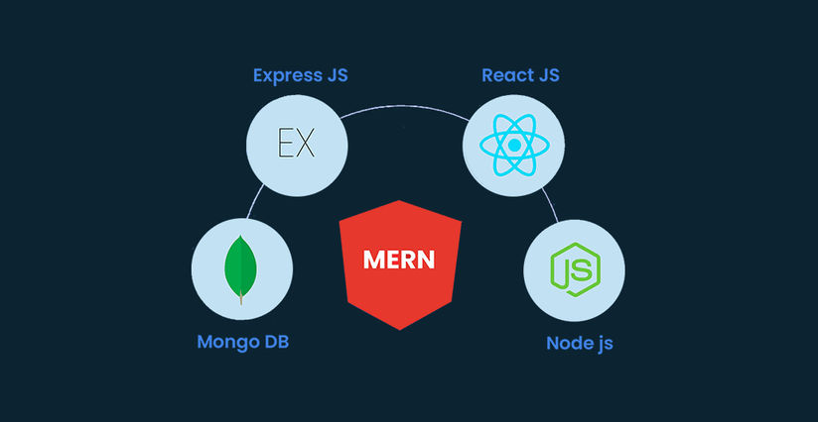


Technologies Employed
Frontend
  React.js
  Tailwind CSS
  Responsive UI design
APIs/Tools
  Clerk – Authentication & user management
  Inngest – Background jobs & email automation
  YouTube Embed – Movie trailers
Backend
  Node.js
  Express.js
Database
  MongoDB

Slide 8
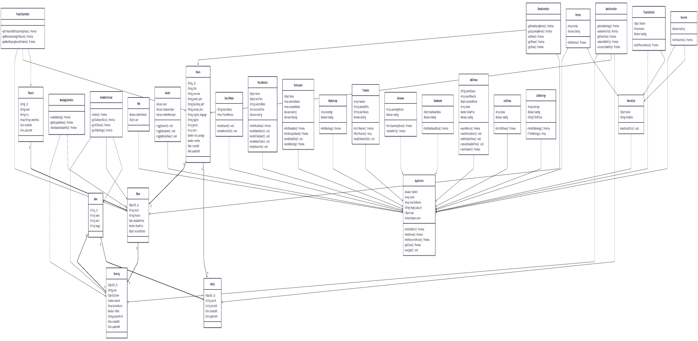
Class Diagram

Slide 9
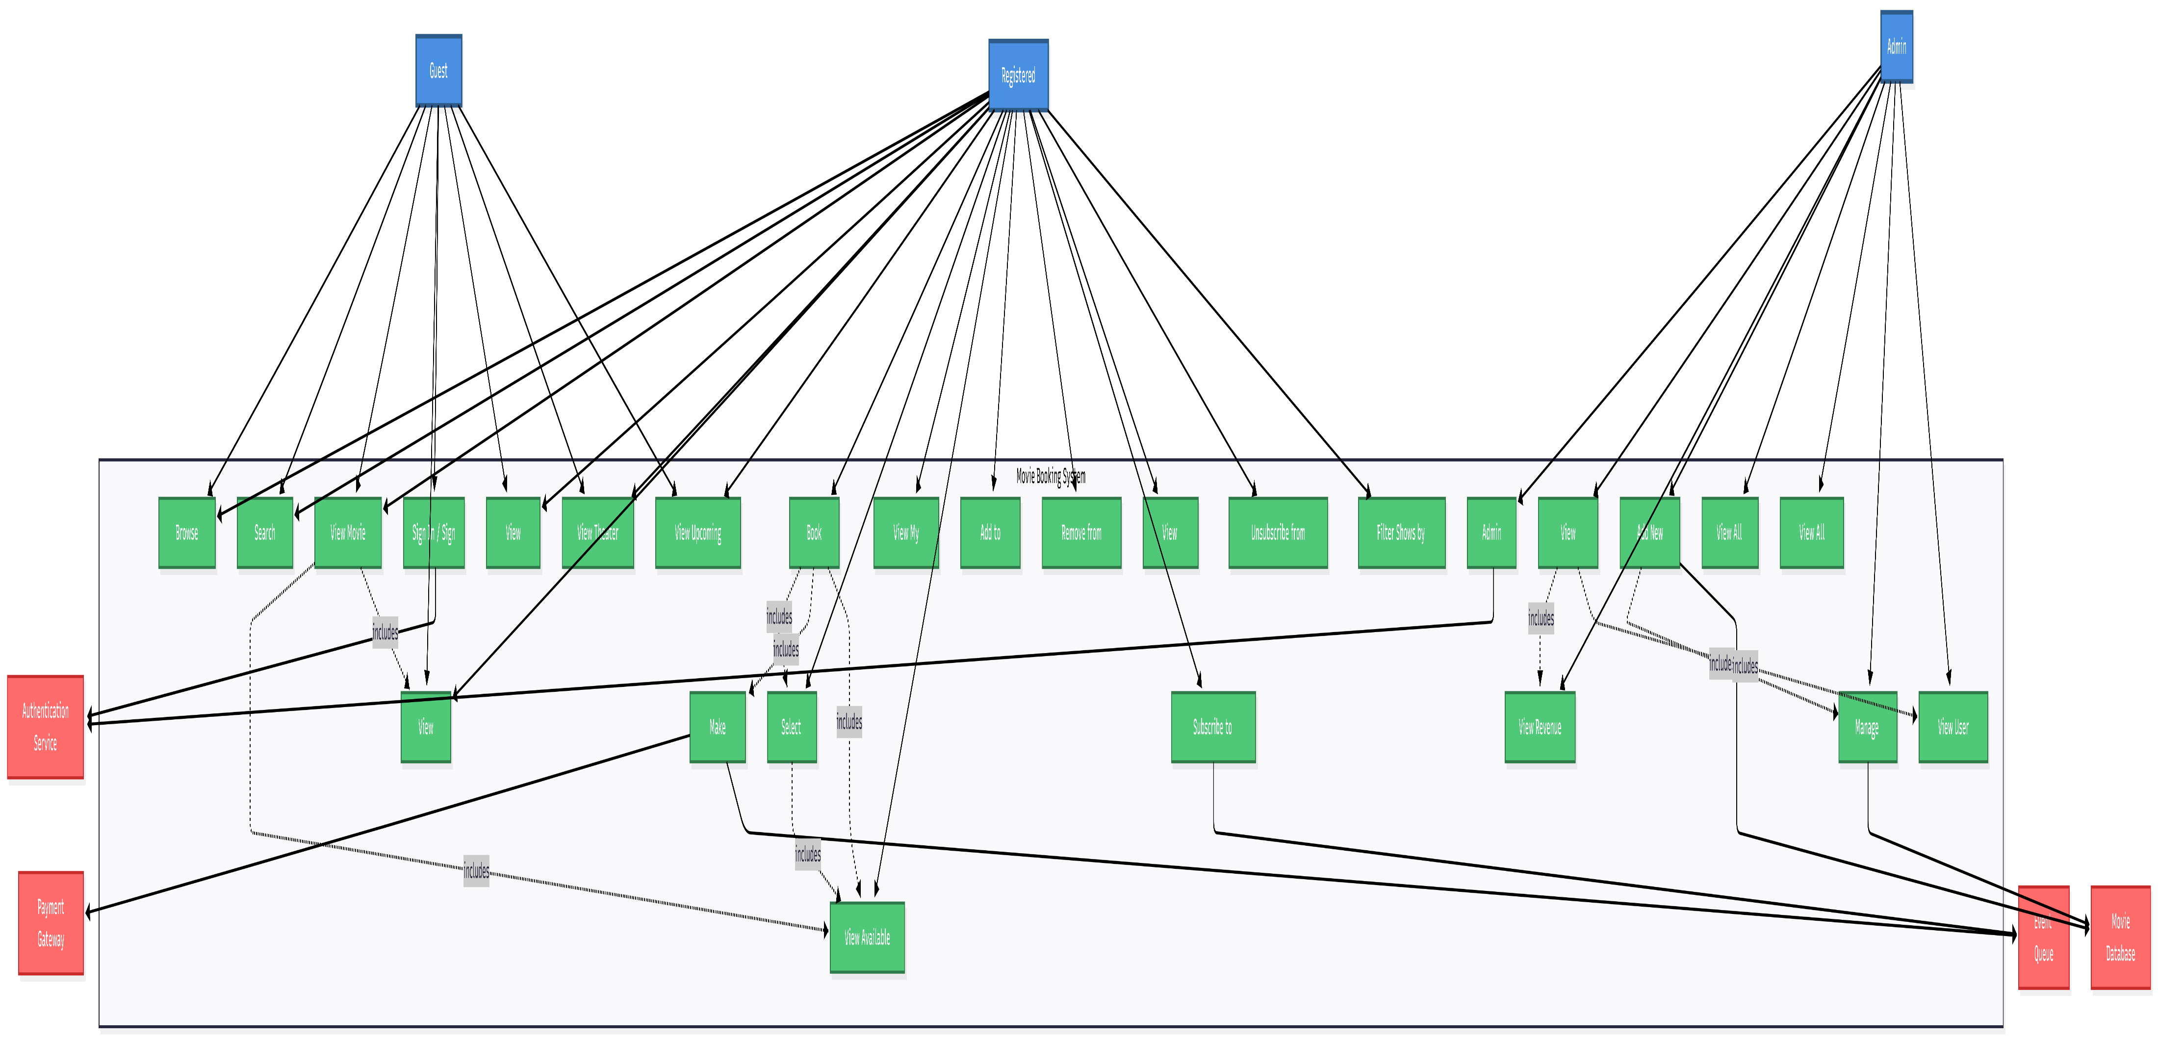
Use Case Diagram

Slide 10

Any Questions for Us?
We appreciate your attention and feedback today
https://movie-ticket-management-ecru.vercel.app/

